Slide 1
Module 11
Recording Relationships
RDA Training
Harold B. Lee Library, Brigham Young University
Fall 2015

Slide 2
Relationships in FRBR
Relationships are crucial in the entity-relationship model FRBR is based on
They serve as the vehicle for depicting the link between one entity and another
They assist the user to navigate within the bibliographic database
Without relationship links it would be next to impossible to find anything
Notes:
Second two bullets are from FRBR 5.1

Slide 3
Entity-Relationship Diagram
Attribute 1
Entity 1
Attribute 2
Relationship
Attribute 1
Entity 2
Attribute 2
Notes:
As we have seen, in the theoretical model any entity can be linked to any other entity by a relationship.

Slide 4

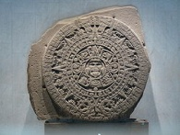


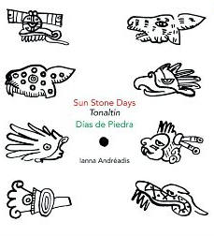
FRBR Relationships
Work-to-work relationships
Derivative relationship
Work: Sun stone
(Aztec calendar)
derivative work
Work: Piedra de sol (poem)
described by
described by
Descriptive relationships
Work: La estela de los soles o Calendario Azteca
Work: Espiral de luz : tiempo y amor en Piedra de sol de Octavio Paz
Work: Días de piedra
Notes:
The exact nature of the relationship is specified.

Slide 5
Relationships in RDA
One of the basic principles of RDA has to do with relationships
0.4.3.3. The data describing a resource should indicate significant relationships between the resource described and other resources.
The data describing an entity associated with a resource should reflect all significant bibliographic relationships between that entity and other such entities.
Notes:
Turn to 0.4.3.3.

Slide 6
Relationships in MARC
We do describe relationships in our current cataloging.
In MARC bibliographic records, relationships of the resource described to other entities are usually expressed by the inclusion of 1XX, 6XX, 7XX, and 8XX fields.
These fields link the description to related entities

Slide 7
AACR2 Bibliographic Record
Link to other records sharing the same author
100 1_ $a Paz, Octavio, $d 1914-1998.
245 10 $a Piedra de sol / $c Octavio Paz ; lectura de Pere Gimferrer.
260 $a Barcelona : $b Mondadori, $c 1998.
300 $a 83 p. ; $c 20 cm.
490 1_ $a Lecturas de poesía ; $v 1
505 2_ $a Lectura de Piedra de sol / Pere Gimferrer.
600 10 $a Paz, Octavio, $d 1914-1998. $t Piedra de sol.
700 1_ $a Gimferrer, Pere, $d 1945-
830 _0 $a Lecturas de poesía ; $v 1.
Link to other records sharing the same subject
Link to other records sharing the same author
Link to other records sharing the same series
Notes:
In a well-designed system these links make it easier for a user to navigate the database. The implementation of RDA in MARC, as we shall see, builds upon this structure.

Slide 8
Relationships in MARC
Relationships can also be expressed in MARC bibliographic records by human-readable text in note fields.

Slide 9
AACR2 Bibliographic Record
100 1_ $a Rowling, J. K.
245 10 $a Harry Potter y el cáliz de fuego / $c J.K. Rowling.
260 $a Barcelona : $b Salamandra, $c 2007, c2004.
300 $a 635 p. ; $c 20 cm.
500 $a Spanish translation of: Harry Potter and the goblet of fire.
500 $a Sequel to: Harry Potter y el prisionero
de Azkaban.
Description of the relationship of this Spanish translation to the English original
Description of the relationship of this resource to the work that preceded it
Notes:
This simplified record would also probably have other types of links, such as a uniform title. However, in the absence of such links, these descriptions are only useful for information; this record will not be linked to the English original or the previous work.

Slide 10
Relationships in MARC
In MARC authority records, relationships of the entity described to other entities are expressed by the inclusion of 5XX fields.
These fields link the description to related entities

Slide 11
AACR2 Authority Record
Link to the description of the earlier entity
110 2_ $a Ricks College (Rexburg, Idaho)
510 2_ $w r $i Predecessor: $a Ricks Normal College (Rexburg, Idaho)
510 2_ $w r $i Successor $a Brigham Young University--Idaho
Link to the description of the later entity

Slide 12
RDA Authority Record
046 $k 1974
100 1_ $a Schickele, Peter. $t Knight of the burning pestle
380 $a Musical comedy
500 1_ $w r $i Adaptation of (work): $a Beaumont, Francis, $d 1584-1616. $t Knight of the burning pestle
Notes:
A much richer array of relationships are possible using RDA. We’ve already seen this in the modules dealing with authority records.

Slide 13
Please log in to RDA
http://access.rdatoolkit.org/login
Notes:
From now on, as I show slides of RDA, please feel free to go ahead and look yourself in the Toolkit.

Slide 14
Primary Relationships
RDA Chapter 17
The Primary Relationships are those between a work and its expression(s), manifestation(s), and item(s).
Recording these relationships should allow the user to:
  find all resources that embody a particular work or a particular expression
  find all items that exemplify a particular manifestation (RDA 17.2)
Notes:
Turn to Chapter 17 in RDA.

Slide 15
Primary Relationships
The relationship between the manifestation and the work is core; if there is more than one expression of the work, the relationship to the expression should also be recorded (RDA 17.3). This means that the record must allow the user to understand what the work (and expression) is.
Common ways to do this:
  Authorized access point for the work or expression
    Mozart, Wolfgang Amadeus, 1756–1791. Kleine Nachtmusik
  Description
    Translation of: Debout les morts
Notes:
Either the authorized access point or the description should allow the user to understand what the work is even if the manifestation has another title, in the first instance that this resource is Eine Kleine Nachtmusik, in the second that it is an expression of the work Debout les morts. The access point allows machine links between the record and other examples of the work; the description does not.
The fact that RDA says this is core means that RDA records must convey this information in some way. We haven’t always been very careful about this in AACR2 records.

Slide 16
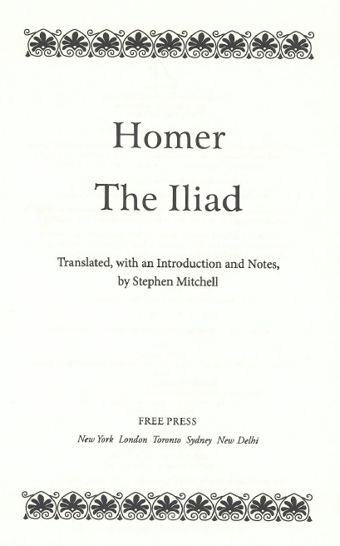
Primary Relationship
Authorized Access point
Notes:
Find your worksheets for the work and expression related to this book, and the bibliographic record we started in the last module.

Slide 17
Primary Relationship (one work)
Authorized Access point
Description of the work (authority record): authorized access point is in 100
040 $a UPB $b eng $e rda $c UPB
046 $k -07
100 0_ $a Homer. $t Iliad
370 $g Ionia $g Turkey
380 $a Poem
400 0_ $a Homer. $t Ilias
400 0_ $a Homer. $t Ἰλιάς
670 $a The Iliad, 2011: $b title page ([by] Homer)
670 $a Oxford classical dictionary, 1996: $b page 718 (Iliad; attributed in the ancient world to Homer)
670 $a Brill’s new Pauly dictionary of Greek and Latin authors and texts, 2009: $b pages 325-326 (Iliad (English); Ilias (Latin); Ἰλιάς (Greek); by Homer, created second half of 8th century BC in Ionia (Asia minor))
Notes:
Find your worksheets for the work and expression related to this book, and the bibliographic record we started in the last module.

Slide 18
Primary Relationship (one work)
Authorized Access point
Description of the expression (authority record): authorized access point is in 100
040 $a UPB $b eng $e rda $c UPB
046 $k 2011 $2 edtf
100 0_ $a Homer. $t Iliad. $l English $s (Mitchell)
377 $a eng
381 $a Mitchell
500 1_ $w r $i Translator: $a Mitchell, Stephen, $d 1943-
670 $a Iliad, 2011: $b title page (translated ... by Stephen Mitchell)
Notes:
The same type of relationship is shown for Piedra de sol

Slide 19
Primary Relationship (one work)
Authorized Access point
Description of the resource (bibliographic record): authorized access point for the work is in 100 + 240 $a. This corresponds to the form found in the authority record, and links the description of the resource to the expression being described. 17.3 requires recording the relationship to the expression if there are more than one.
100 0_ $a Homer, $e author.
240 10 $a Iliad. $l English $s (Mitchell)
245 14 $a The Iliad / $c Homer ; translated, with an introduction and notes, by Stephen Mitchell.
...
Notes:
You’ll notice that the same two fields also link the description to the expression of the work. This can work because the authorized access point for the work is embedded in the authorized access point for the expression. In this case according to RDA 17.3 it must also record the relationship to the expression because there are more than one.

Slide 20
Entity-Relationship structure
Work: Iliad
created by
Person: Homer
realized through
Expression: an English expression
Expression: original Greek Expression
has a translation
Person: Stephen Mitchell
translated by
Notes:
The MARC links show the same relationships as the entity-relationship structure shown here, but somewhat less clearly.

Slide 21
Primary Relationship (one work)
Authorized Access point
Description of the work (authority record): authorized access point is in 100
040 $a UPB $b eng $e rda $c UPB
046 $k 1957 $2 edtf
100 1_ $a Paz, Octavio, $d 1914-1998. $t Piedra de sol
370 $g Mexico
380 $a Poem
670 $a Piedra de sol, 1957
Notes:
The same type of relationship is shown for Piedra de sol

Slide 22
Primary Relationship (one work)
Authorized Access point
Description of the expression (authority record): authorized access point is in 100
040 $a UPB $b eng $e rda $c UPB
046 $k 1957 $2 edtf
100 1_ $a Paz, Octavio, $d 1914-1998. $t Piedra de sol. $l English $s (Rukeyser)
377 $a eng
381 $a Rukeyser
400 1_ $a Paz, Octavio, $d 1914-1998. $t Sun stone
500 1_ $w r $i Translator: $a Rukeyser, Muriel, $d 1913-1980
670 $a Sun stone = Piedra de sol, 1957: $b title page (translation by Muriel Rukeyser)
Notes:
The same type of relationship is shown for Piedra de sol

Slide 23

Primary Relationship (one work)
Authorized Access point
Description of the resource (bibliographic record): authorized access point for the work is in 100 + 240 $a. This corresponds to the form found in the authority record, and links the description of the resource to the work and expression being described.
100 1_ $a Paz, Octavio, $d 1914-1998, $e author.
240 10 $a Piedra de sol. $l English $s (Rukeyser)
245 10 $a Sun stone = $b Piedra de sol / $c Octavio Paz ; translation by Muriel Rukeyser.
...
Notes:
Again, the description of the resource is linked to the description of the work. In this case according to RDA 17.3 it must also record the relationship to the expression because there are more than one.

Slide 24

Primary Relationship (one work)
Authorized Access point
Short cut commonly used: Description of the resource: authorized access point for the work is in 100 + 245 $a. If this corresponds to the form found in the authority record, the description of the resource is considered linked to the work being described. Less of a clear link than using the controlled fields.
100 1_ $a Paz, Octavio, $d 1914-1998, $e author.
245 10 $a Piedra de sol / $c Octavio Paz.
...
Notes:
In AACR2 LC practice, if the title proper matched exactly the preferred title of the authorized access point for the work, no 240 was used, that is, the authorized access point for the work was not recorded in a controlled field. This is still the practice in the majority of cases: all works have an authorized access point, but in the current MARC environment it isn’t usual to establish the authorized access point by creating an authority record for it, especially if the form in the 100 plus the form in 245 subfield $a is in fact the authorized access point. This practice may be gradually changing.

Slide 25
Primary Relationship
(more than one work or expression)
Authorized Access point
If the resource contains more than one work or expression, the 1XX/24X technique is not used.
Authorized access point for each work or expression is recorded in 7XX field.
Notes:
If there are more than one work or expression, record each in a 7XX field. This is a change from practice under AACR2.

Slide 26
Primary Relationship
(more than one work or expression)
Authorized Access point
AACR2
100 1_ $a Silva, Julian, $d 1927-
240 10 $a Gunnysack castle
245 10 $a Distant music : $b two novels / $c Julian Silva.
700 12 $a Silva, Julian, $d 1927- $t Death of Mae Ramos.
RDA
100 1_ $a Silva, Julian, $d 1927- $e author.
245 10 $a Distant music : $b two novels / $c Julian Silva.
700 12 $i Container of (work): $a Silva, Julian, $d 1927- $t Gunnysack castle.
700 12 $i Container of (work): $a Silva, Julian, $d 1927- $t Death of Mae Ramos.
Notes:
If there are more than one work or expression, record each in a 7XX field. This is a change from practice under AACR2.
Here we have two works by the same author.

Slide 27
Primary Relationship
(more than one work or expression)
Authorized Access point
AACR2
100 1_ $a López Colomé, Pura, $d 1952-
240 10 $a Santo y seña. $l English & Spanish
245 10 $a Watchword / $c Pura López Colomé ; translated by Forrest Gander.
RDA
100 1_ $a López Colomé, Pura, $d 1952- $e author.
245 10 $a Watchword / $c Pura López Colomé ; translated by Forrest Gander.
700 12 $i Container of (expression): $a López Colomé, Pura, $d 1952- $t Santo y seña. $l Spanish.
700 12 $i Container of (expression): $a López Colomé, Pura, $d 1952- $t Santo y seña. $l English.
OR
100 1_ $a López Colomé, Pura, $d 1952- $e author.
245 10 $a Watchword / $c Pura López Colomé ; translated by Forrest Gander.
700 12 $i Container of (work): $a López Colomé, Pura, $d 1952- $t Santo y seña.
700 12 $i Container of (expression): $a López Colomé, Pura, $d 1952- $t Santo y seña. $l English.
Notes:
In this case we have two expressions of the same work. Note the 700s in the second RDA example follow LC practice, that is, to represent the expression in the original language they record the authorized access point for the work (not expression); it would also be permissible to use an authorized access point for the Spanish expression, as shown in the first RDA example.
In either case, for the translation LC records the authorized access point for the expression. In this case there’s only one translation so no need to differentiate between English expressions.

Slide 28
Relationships between resources and Persons, Families, Corporate Bodies
A resource is a work, expression, manifestation, or item.
RDA 18-22 describe how to relate resources to persons, families, or corporate bodies.

Slide 29
Core relationship
There is only one core (required) relationship: the relationship between the creator of a work and the work. Expressing other relationships is optional (RDA 18.3)
If there are more than one creator, only the relationship to the creator having principal responsibility, or named first, is required.
Notes:
Open to RDA 18.3

Slide 30
Creator on the Bibliographic Record
RDA does not have the concept of main entry, but it does have the concept of principal responsibility
RDA has the same categories as AACR2:
  Works created by one person, family, or corporate body (RDA 6.27.1.2)
  Collaborative works (RDA 6.27.1.3)
  Compilations of works by different persons, families, or corporate bodies (RDA 6.27.1.4)

Slide 31
Creator on the Bibliographic Record:
One Person, Family, or Corporate Body
6.27.1.2. If one person, family, or corporate body is responsible for creating the work, construct the authorized access point representing the work by combining (in this order):
  the authorized access point representing that person, family, or corporate body
  the preferred title for the work
Although this is an instruction for creation of an access point, we can infer that such works have a principal creator and that creator is recorded in 1XX of the bibliographic record.

Slide 32
Corporate bodies as creators
RDA 19.2.1.1.1. Corporate bodies are considered to be creators if they generate
  Works of an administrative nature dealing with the body itself
  Works that record the collective thought of the body
  Works that record hearings
  Works that record the collective activity of a meeting/expedition, etc.
  Some works resulting from the collective activity of a performing group
  Cartographic works originating with the body (aside from publisher)
  Certain legal works
  Named individual works of art by two or more artists acting as a corporate body
Notes:
Open to RDA 19.2--IMPORTANT! Similar to AACR2 21.1B2. In most cases it’s easy to see if a person or family is the creator of a work, but with corporate bodies it’s trickier so it’s been spelled out here.

Slide 33
Creator on the Bibliographic Record: Collaborative Work
6.27.1.3. If two or more persons, families, or corporate bodies are collaboratively responsible for creating the work, construct the authorized access point representing the work by combining (in this order):
  the authorized access point representing the person, family, or corporate body with principal responsibility for the work (or named first)
  the preferred title for the work
Although this is an instruction for creation of an access point, we can infer that such works have a principal creator and that creator is recorded in 1XX of the bibliographic record, no matter how many other collaborators there are. This is a change from AACR2.
Notes:
Emphasize: no rule of three.

Slide 34
Creator on the Bibliographic Record: Compilations
6.27.1.4. If the work is a compilation of works by different persons, families, or corporate bodies, construct the authorized access point representing the work using the preferred title for the compilation
Although this is an instruction for creation of an access point, we can infer that such works are regarded as having no creator and therefore no creator is recorded in 1XX of the bibliographic record. This the same as AACR2.
Reminder: a compilation is considered a work in itself, in addition to the works contained within it.

Slide 35

Core relationship
The creator of this work is J.K. Rowling.
The translators of the English expression of this work are Adolfo Muñoz García and Nieves Martín Azofra.
Only the relationship to Rowling is required to be expressed in the RDA record. Others are optional.

Slide 36
Recording the relationship
We can record the relationship using an identifier (a code link) or an authorized access point.
Typically in a MARC record, the relationship link to the creator is given in a 1XX field
    100 1_ $a Rowling, J. K. [the creator]
Other relationship links are given in 7XX fields
    700 1_ $a Martín Azofra, Nieves [the translator]

Slide 37
Relationship Designator
18.5. A relationship designator indicates the nature of the relationship between a resource and a person, family, or corporate body.
Relationship designators are optional, but encouraged.
Without a designator we would know there is a relationship, but might not know its nature. For example, the presence of
700 1_ $a Martín Azofra, Nieves.
in the record does not tell us what Martín Azofra’s relationship is to Harry Potter y el cáliz de fuego. What did this person do?
Notes:
Open to 18.5. Read.

Slide 38
Relationship Designator
Appendix I contains relationship designators for relationships between resources and persons, families, and corporate bodies.
Another list of relationship designators is found at www.loc.gov/marc under “relators.”
In MARC, they are recorded in $e.
    100 1_ $a Rowling, J. K., $e author.
    700 1_ $a Martín Azofra, Nieves, $e translator.
Notes:
Look at Appendix I together. These lists are controlled, but not closed. This means we should use vocabulary from the lists, but if a term we need isn’t there we can use another source. 18.5.1.3 says “If none of the terms listed in appendix I is appropriate or sufficiently specific, use a term designating the nature of the relationship as concisely as possible.” This means start with Appendix I. If you don’t find an appropriate term there you can then procede to another list, or make one up. We recommend using controlled vocabularies rather than making up terms, so go to the MARC list.

Slide 39
Relationship Designator
RDA Record
100 1_ $a Rowling, J. K., $e author.
240 10 $a Harry Potter and the goblet of fire. $l Spanish
245 10 $a Harry Potter y el cáliz de fuego / $c J.K. Rowling.
264 _1 $a Barcelona : $b Salamandra, $c [2007]
300 $a 635 pages ; $c 20 cm
...
500 $a Spanish translation of: Harry Potter and the goblet of fire.
500 $a Sequel to: Harry Potter y el prisionero
de Azkaban.
700 1_ $a Muñoz García, Adolfo, $e translator.
    700 1_ $a Martín Azofra, Nieves, $e translator.

Slide 40
Recording Relationships
Between Works
RDA Chapters 24 and 25.
Relationships may be recorded either by an identifier (coded link), an authorized access point; or a description.
If the authorized access point is used, it may include a relationship designator to indicate the nature of the relationship.
These relationship designators are found in Appendix J2.
Notes:
Look at J2 together.

Slide 41
Recording Relationships
Between Works: Description
100 1_ $a Rowling, J. K., $e author.
240 10 $a Harry Potter and the goblet of fire. $l Spanish
245 10 $a Harry Potter y el cáliz de fuego / $c J.K. Rowling.
264 _1 $a Barcelona : $b Salamandra, $c [2007]
300 $a 635 pages ; $c 20 cm
...
500 $a Spanish translation of: Harry Potter and the goblet of fire.
500 $a Sequel to: Harry Potter y el prisionero de Azkaban.
700 1_ $a Muñoz García, Adolfo, $e translator.
    700 1_ $a Martín Azofra, Nieves, $e translator.

Slide 42
Recording Relationships
Between Works: Authorized Access Point
100 1_ $a Rowling, J. K., $e author.
240 10 $a Harry Potter and the goblet of fire. $l Spanish
245 10 $a Harry Potter y el cáliz de fuego / $c J.K. Rowling.
264 _1 $a Barcelona : $b Salamandra, $c [2007]
300 $a 635 pages ; $c 20 cm
...
700 1_ $i Translation of: $a Rowling, J. K. $t Harry Potter and the goblet of fire.
700 1_ $i Sequel to: $a Rowling, J. K. $t Harry Potter and the prisoner of Azkaban.
700 1_ $a Muñoz García, Adolfo, $e translator.
    700 1_ $a Martín Azofra, Nieves, $e translator.
Relationship designator
Authorized access point
Notes:
This shows the relationship between one work, the work Harry Potter and the prinsoner of Azkaban and its sequel, the work Harry Potter and the goblet of fire, realized through this Spanish translation.

Slide 43
Relationships between Works:
Whole-Part Relationship
A particularly important type of relationship
As with other types of relationship, it can be recorded either by a description (e.g., a contents note) or by authorized access points, or both.

Slide 44
Relationships between Works:
Whole-Part Relationship
100 1_ $a Paz, Octavio, $d 1914-1998, $e author.
245 10 $a Cuadrivio : $b Diarío, López Velarde, Pessoa, Cenuda / $c Octavio Paz.
...
505 0_ $a El caracol y la sirena : Rubén Diarío -- El camino de la pasión : Ramón López Velarde -- El desconocido de sí mismo : Fernando Pessoa -- La palabra edificante : Luis Cernuda.
Each essay is a work; the anthology Cuadrivio is also a work. The whole-part relationship between these works is here expressed in a description.
Notes:
Look together at Chapter 25. This is the only place in RDA where a contents note is mentioned, and it’s only in the examples of structured descriptions.

Slide 45
Relationships between Works:
Whole-Part Relationship
100 1_ $a Paz, Octavio, $d 1914-1998, $e author.
245 10 $a Cuadrivio : $b Diarío, López Velarde, Pessoa, Cenuda / $c Octavio Paz.
...
700 12 $i Container of (work): $a Paz, Octavio, $d 1914-1998. $t Caracol y la sirena.
700 12 $i Container of (work): $a Paz, Octavio, $d 1914-1998. $t Camino de la pasión.
700 12 $i Container of (work): $a Paz, Octavio, $d 1914-1998. $t Desconocido de sí mismo.
700 12 $i Container of (work): $a Paz, Octavio, $d 1914-1998. $t Palabra edificante.
Each essay is a work; the anthology Cuadrivio is also a work. The whole-part relationship between these works is here expressed using authorized access points.
Notes:
Note there is no rule of three preventing as many of these analytic access points as we want to add.

Slide 46
Recording Relationships
Between Expressions and other Resources
RDA Chapters 24 and 26.
Relationships may be recorded either by an identifier (coded link), an authorized access point; or a description.
If the authorized access point is used, it may include a relationship designator to indicate the nature of the relationship.
These relationship designators are found in Appendix J3.
Notes:
Look at J3 together.

Slide 47
Recording Relationships
Between Expressions: Description
100 1_ $a Rowling, J. K., $e author.
245 10 $a Harry Potter y el cáliz de fuego / $c J.K. Rowling.
264 _1 $a Barcelona : $b Salamandra, $c [2007]
300 $a 635 pages ; $c 20 cm
...
500 $a Spanish translation of: Harry Potter and the goblet of fire.
500 $a Sequel to: Harry Potter y el prisionero de Azkaban.
700 1_ $a Muñoz García, Adolfo, $e translator.
    700 1_ $a Martín Azofra, Nieves, $e translator.

Slide 48
Recording Relationships
Between Expressions: Authorized Access Point
100 1_ $a Rowling, J. K., $e author.
245 10 $a Harry Potter y el cáliz de fuego / $c J.K. Rowling.
264 _1 $a Barcelona : $b Salamandra, $c 2007, ©2004.
300 $a 635 pages ; $c 20 cm
...
700 1_ $i Translation of: $a Rowling, J. K. $t Harry Potter and the goblet of fire.
700 1_ $i Sequel to: $a Rowling, J. K. $t Harry Potter and the prisoner of Azkaban.
700 1_ $a Muñoz García, Adolfo, $e translator.
    700 1_ $a Martín Azofra, Nieves, $e translator.
Relationship designator
Authorized access point
Notes:
This shows the relationship between an expression, Harry Potter y el cáliz de fuego, and the English work it translates.

Slide 49
Bibliographic or Authority Record?
RDA does not specify what kind of record should record these relationships
Relationships can also be recorded in authority records.

Slide 50
Relationships in Authority Records
Work to work
100 1_ Rowling, J. K. $t Harry Potter and the goblet of fire
500 1_ $w r $i Sequel to: $a Rowling, J. K. $t Harry Potter and the prisoner of Azkaban

Slide 51
Relationships in Authority Records
Expression to work and to translator
100 1_ Rowling, J. K. $t Harry Potter and the goblet of fire. $l Spanish
400 1_ Rowling, J. K. $t Harry Potter y el cáliz de fuego
500 1_ $w r $i Translation of: $a Rowling, J. K. $t Harry Potter and the goblet of fire
500 1_ $w r $i Translator: $a Muñoz García, Adolfo
500 1_ $w r $i Translator: $a Martín Azofra, Nieves
Notes:
Especially the relationship between contributors and expressions is becoming more common in authority records.

Slide 52
Relationships Between Persons, Families, and Corporate Bodies
RDA Chapters 29-32.
These relationships may describe how persons, families, or corporate bodies (in any combination) are associated with each other.
The purpose of describing these relationships is to help users
  find related entities
  understand the relationship between entities

Slide 53
Relationships Between Persons, Families, and Corporate Bodies
The relationship may be recorded by an identifier (coded link) or an authorized access point.
These relationships are normally expressed in MARC authority records, using the 5XX field
    110 2_ $a Donny & Marie
    500 1_ $w r $i Member: $a Osmond, Donny
    500 1_ $w r $i Member: $a Osmond, Marie, $d 1959-
Notes:
In this example, the relationship between the persons Donny Osmond and Marie Osmond, and the musical group Donny & Marie, is recorded by using 500 fields in the authority record for the musical group.

Slide 54
Relationship Designators
To clarify the nature of the relationship, relationship designators may optionally be added
Relationship designators for relationships between persons, families, and corporate bodies, are found in Appendix K
These designators are coded in authority format 5XX $i in combination with $w r.

Slide 55
Relationship Designators
110 2_ $a Paramount Pictures Corporation (1914-1927)
372 $a Motion picture distribution
510 2_ $w r $i Product of a merger: $a Paramount Famous Lasky Corporation
500 1_ $w r $i Founder: $a Hodkinson, W. W. $q (William Wadsworth), $d 1881-1971
Notes:
In this case the relationship designators clarify the relationship between Paramount Pictures Corporation and Paramount Famous Lasky Corporation (it merged with another company to become Paramount Famous Lasky Corporation) and the relationship between the corporate body and W.W. Hodkinson, who was the founder of the company.

Slide 56

A few changes from AACR2
No rule of three. As many relationships as desired may be expressed.
AACR2 catalog access point
700 1_ $a Weisburd, David.
RDA catalog access points (potential)
700 1_ $a Weisburd, David, $e editor.
700 1_ $a Feucht, Thomas E., $e editor.
700 1_ $a Hakimi, Idit, $e editor.
700 1_ $a Mock, Lois Felson, $e editor.
700 1_ $a Perry, Simon, $e editor.

Slide 57
A few changes from AACR2
Access points do not need to be justified in the description--no note required to justify the analytic access points on this record.
100 1_ $a Paz, Octavio, $d 1914-1998, $e author.
245 10 $a Cuadrivio : $b Diarío, López Velarde, Pessoa, Cenuda / $c Octavio Paz.
264 _1 $a Barcelona : $b Editorial Seix Barral, $c 1991.
300 $a 139 pages ; $b 19 cm
700 12 $i Container of (work): $a Paz, Octavio, $d 1914-1998. $t Caracol y la sirena.
700 12 $i Container of (work): $a Paz, Octavio, $d 1914-1998. $t Camino de la pasión.
700 12 $i Container of (work): $a Paz, Octavio, $d 1914-1998. $t Desconocido de sí mismo.
700 12 $i Container of (work): $a Paz, Octavio, $d 1914-1998. $t Palabra edificante.

Slide 58
Exercise
Recording Relationships in Bibliographic Records
Do we want to bring out any relationships in our records?
Remember, creator of the work is core. Which of our resources has a creator?
Notes:
Get out your bib records and authority records; also we’ll pass out a complete set of needed authority records now for ones you haven’t already done.

Slide 59
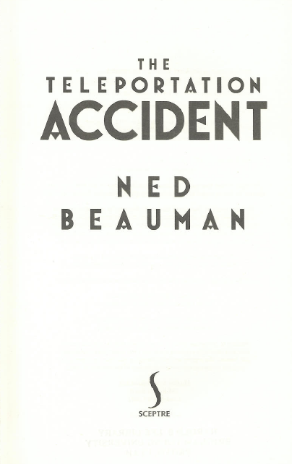
Add creator to worksheet, with relationship designator, if appropriate

Slide 60
Add creator to worksheet, with relationship designator, if appropriate
100 1_ $a Beauman, Ned, $d 1985- $e author.

Slide 61
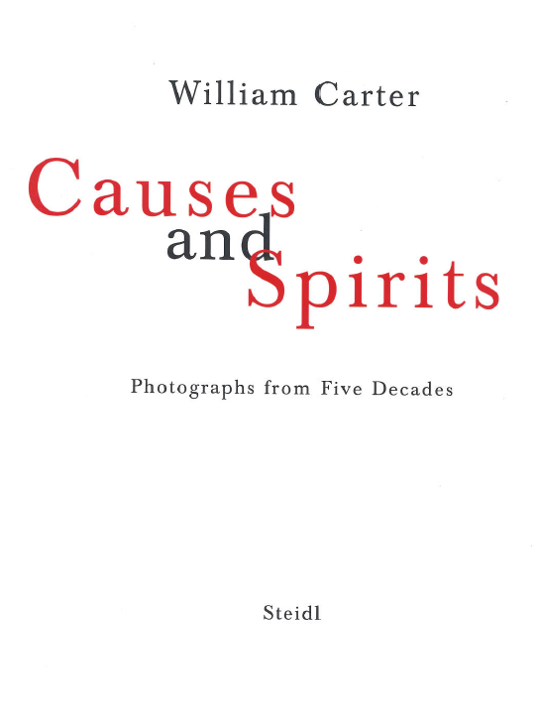
Add creator to worksheet, with relationship designator, if appropriate

Slide 62
Add creator to worksheet, with relationship designator, if appropriate
100 1_ $a Carter, William, $d 1934- $e photographer.

Slide 63
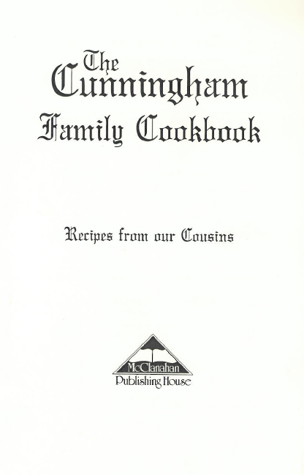
Add creator to worksheet, with relationship designator, if appropriate

Slide 64
Add creator to worksheet, with relationship designator, if appropriate
100 3_ $a Cunningham (Family : $d 1795- : $c Trigg County, Ky.), $e author.

Slide 65
Add creator to worksheet, with relationship designator, if appropriate

Slide 66
Add creator to worksheet, with relationship designator, if appropriate
100 0_ $a Homer, $e author.

Slide 67
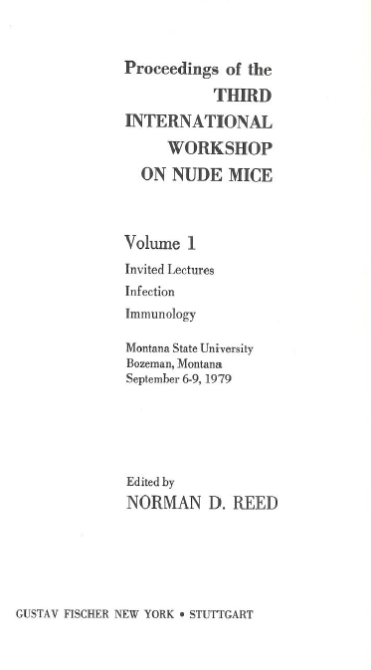
Add creator to worksheet, with relationship designator, if appropriate

Slide 68
Add creator to worksheet, with relationship designator, if appropriate
111 2_ $a International Workshop on Nude Mice $n (3rd : $d 1979 : $c Montana State University (Bozeman, Mont.)), $e author.

Slide 69
Add creator to worksheet, with relationship designator, if appropriate

Slide 70
Add creator to worksheet, with relationship designator, if appropriate
100 1_ $a Paz, Octavio, $d 1914-1998, $e author.

Slide 71
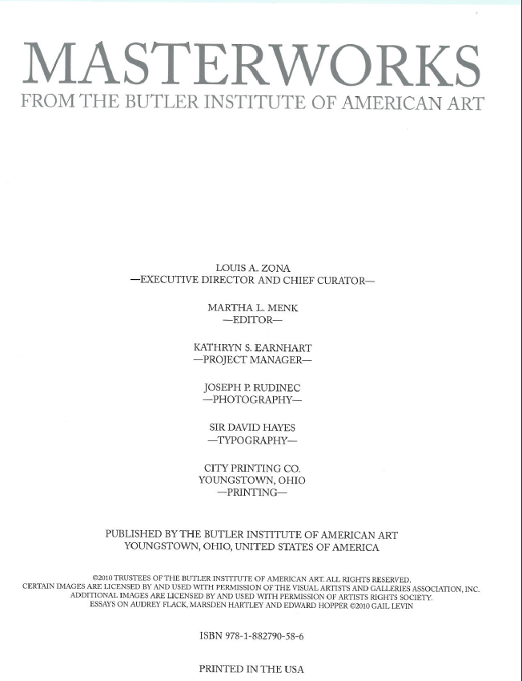
Add creator to worksheet, with relationship designator, if appropriate

Slide 72
Add creator to worksheet, with relationship designator, if appropriate
110 2_ $a Butler Institute of American Art, $e author.
19.2.1.1.1a work of an administrative nature dealing with the body itself (a catalog of some of its art); the body is responsible for originating the work.
Notes:
Read 19.2.1.1.1a if people look puzzled

Slide 73

Add creator to worksheet, with relationship designator, if appropriate

Slide 74
Add creator to worksheet, with relationship designator, if appropriate
No principal creator -- this is a compilation of works by different persons (6.27.1.4)

Slide 75
Exercise
Recording Relationships in Bibliographic Records
Do we want to bring out any other relationships in our records?
Remember, creator of the work is core. Others are optional. Would it be helpful to our users to record others in any of the resources we’ve been cataloging?

Slide 76
Add other relationships to worksheet, with designators, if appropriate

Slide 77
Add other relationships to worksheet, with designators, if appropriate
None.

Slide 78
Add other relationships to worksheet, with designators, if appropriate

Slide 79
Add other relationships to worksheet, with designators, if appropriate
None.

Slide 80
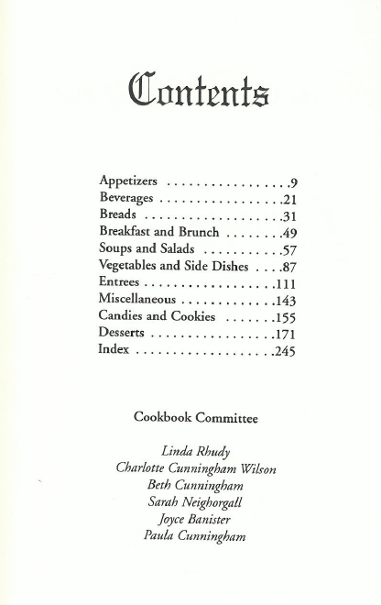
Add other relationships to worksheet, with designators, if appropriate

Slide 81
Add other relationships to worksheet, with designators, if appropriate
Possibly
700 1_ $a Rhudy, Linda, $e editor of compilation.
700 1_ $a Wilson, Charlotte Cunningham, $e editor.
700 1_ $a Cunningham, Beth, $e editor.
700 1_ $a Neighorgall, Sarah, $e editor.
700 1_ $a Banister, Joyce, $e editor.
700 1_ $a Cunningham, Paula, $e editor.
Notes:
This probably depends on how important these family members are to our library. At BYU probably not, but if I were at a local library in Kentucky I’d probably want them.

Slide 82
Add other relationships to worksheet, with designators, if appropriate

Slide 83
Add other relationships to worksheet, with designators, if appropriate
relationship to the expression in the resource
240 10 $a Iliad. $l English $s (Mitchell)
relationship to a person
700 1_ $a Mitchell, Stephen, $d 1943- $e translator.
Notes:
We usually record relationships to translators.

Slide 84
Add other relationships to worksheet, with designators, if appropriate

Slide 85
Add other relationships to worksheet, with designators, if appropriate
700 1_ $a Reed, Norman D., $d 1935- $e editor.
Notes:
We usually record relationships to editors.

Slide 86
Add other relationships to worksheet, with designators, if appropriate

Slide 87
Add other relationships to worksheet, with designators, if appropriate
relationship to the expressions in the resource
700 12 $i Container of (expression): $a Paz, Octavio, $d 1914-1998. $t Piedra de sol. $l Spanish.
700 12 $i Container of (expression): $a Paz, Octavio, $d 1914-1998. $t Piedra de sol. $l English $s (Rukeyser)
relationship to a person
700 1_ $a Rukeyser, Muriel, $d 1913-1980, $e translator.
relationships to another work
830 _0 $a World poets series.
Notes:
Note: the series is a work to work relationship.

Slide 88
Add other relationships to worksheet, with designators, if appropriate

Slide 89
Add other relationships to worksheet, with designators, if appropriate
700 1_ $a Menk, Martha L., $e editor.
possibly
700 1_ $a Rudinec, Joseph P., $e photographer.
Notes:
The work is heavily illustrated with photographs so it might be appropriate to record a relationship to the photographer. On the other hand, most of the photographs are reproductions of art works, not directly the work of the photographer.

Slide 90
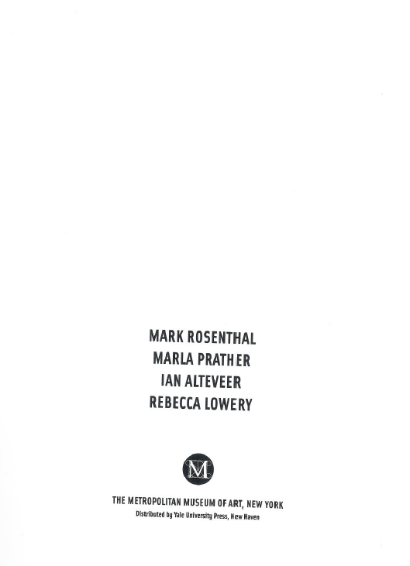
Add other relationships to worksheet, with designators, if appropriate

Slide 91
Add other relationships to worksheet, with designators, if appropriate
700 1_ $a Rosenthal, Mark, $d 1945- $e author.
700 1_ $a Prather, Marla, $d 1956- $e author.
700 1_ $a Alteveer, Ian, $e author.
700 1_ $a Lowery, Rebecca, $e author.
No principal creator -- this is a compilation of works by different persons (6.27.1.4)
Notes:
NOTE: Even though there is no principal creator, the four persons named on the title page are authors of parts of the work--they are still creators.

Slide 92
Exercise
Congratulations! We’ve completed eight bibliographic records!
Add appropriate relationships to the bibliographic records for resources you’ve brought.

Slide 93
Module 11
Recording Relationships
Questions?
RDA Training
Harold B. Lee Library, Brigham Young University
Fall 2015

Slide 94
This Presentation is available at
http://net.lib.byu.edu/~catalog/people/rlm/RDAUtah201511/index.htm
For further information
contact Robert L. Maxwell
robert_maxwell@byu.edu

